Slide 1
COMPONENTS
"React abstracts away the DOM from you, giving a simpler programming model and better performance."

Slide 2
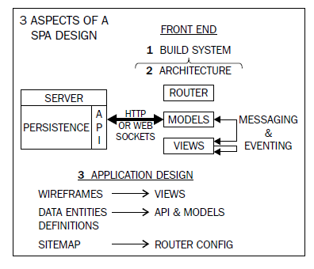
SPA Design

Slide 3
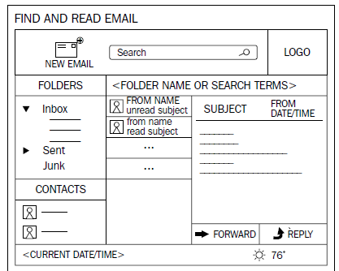
SPA Design - wireframe

Slide 4
Props
props :
read only properties in react used in components to update UI
prop is used to define a component that can take arguments via the component's HTML element attributes.
props are immutable and not dynamic. To change the value of a prop requires re-rendering the component.

Slide 5
props
var HelloReact = React.createClass({
render: function() {
var localMessage = this.props.message; // copy to variable
return (
<div>
<div>Hello React</div>
<p>{localMessage + ‘ and from jsx’}</p>
<div>{this.props.message} </div>
</div>
);
}
});
ReactDOM.render(
<HelloReact message='Message from props'/>,
document.getElementById('view'));

Slide 6
propTypes
Used to validate props
var HelloReact = React.createClass({
propTypes: { // this works only for development, warnings will be only shown
message: React.PropTypes.string,
number: React.PropTypes.number,
requiredString: React.PropTypes.string.isRequired
},
render: function() {
return (
<div>
<div>Hello React</div>
<div>{this.props.message}</div>
</div>
);
}
});
ReactDOM.render(<HelloReact message='How are you' number='not a number'/>,
document.getElementById('view'));
Warning: Failed propType: Invalid prop `number` of type `string` supplied to `HelloReact`, expected `number`. (in console of debugger you can see)
Warning: Failed propType: Required prop `requiredString` was not specified in `HelloReact`.

Slide 7
getDefaultProps
Provide default property values that will get used if an attribute isn't specified in the HTML markup declaring our component.
var HelloReact = React.createClass({
getDefaultProps: function() {
return {
message: 'I am from default'
};
},
….
});
ReactDOM.render( <HelloReact />,
document.getElementById('view'));

Slide 8
state
state : used to mutate the component state to reflect changes in DOM. React component’s state allows for dynamic behavior.
geInitialState() is used to set default state
Note :
this.setState() method will merge the existing this.state with the object that is passed in.
This means that you only need to specify the properties that you want to update as it will not delete any properties that are not defined in the JSON object, which are currently defined on this.state.

Slide 9
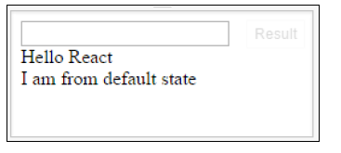
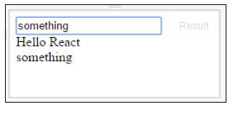
state
var HelloReact = React.createClass({
getInitialState: function() {
return {
message: 'I am from default state'
};
},
updateMessage: function(e) {
this.setState({message: e.target.value});
},
render: function() {
return (
<div>
<input type='text' onChange={this.updateMessage}/>
<div>Hello React</div>
<div>{this.state.message}</div>
</div>
); } }); ReactDOM.render( <HelloReact />,document.getElementById('view'));
React will re-render our component to update

Slide 10
Props vs state
Props are immutable.
Props should not be updated by the component to which they are passed.
Props are owned by the component which passes them to some other component.
State is internal and private to the component.
State can and will change depending on the interactions with the outer world. (Avoid state as far as possible)
State should store as simple data as possible, such as whether an input checkbox is checked or not or a CSS class that hides or displays the component.
Use props for static data and state for dynamic data

Slide 11
Note
If a component does not change, then there is no need to use state.
It's better to depend on props passed by the parent component in that case.
This also avoids re-rendering of the component again and again as changes to state initiate a re-render of the component.

Slide 12
Props and state
When do you use props or state, or even just private variables?
Props are used for passing data between child and parent React classes, and any changes to a prop cause an automatic re-render of the view, both parent and child.
For data that’s relevant only to the view and nothing else, use state. Any changes here also rerender the view.
For any data that’s pertinent to the class but not the view itself, you could use a private variable

Slide 13
Components and Component Life cycle

Slide 14
Components
Object oriented widgets definition
Nested widgets support
HTML like widget DOM definition (Virtual DOM)
State spreading to nested components-
ONE WAY REACTIVE DATA FLOW
Optimized rendering to the real DOM tree
Two-way data binding helpers

Slide 15
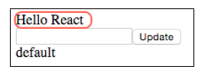
Components
var HelloMessage = React.createClass({
render: function() {
return <div>{this.props.message}</div>;
}
});
Application by created using a Domain Specific Language (DSL). Now JSX markup is made up of readable custom tags like HelloMessage instead of blocks of HTML markup.

Slide 16
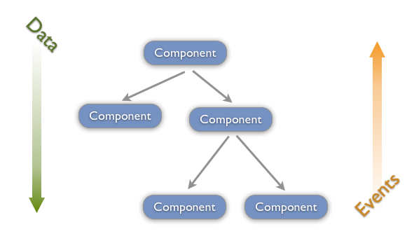
Data Flow

Slide 17
Components
//refs is to refer a component decorated with ref
var HelloMessage = React.createClass({
getInitialState: function() {
return { message: 'default'}
},
updateMessage: function () {
console.info('updateMessage');
this.setState({
message: this.refs.messageTextBox.value
});
},

Slide 18
Components
render: function() {
return (
<div>
<HelloMessage message='Hello React'></HelloMessage>
<input type='text' ref='messageTextBox' />
<button onClick={this.updateMessage}>Update</button>
<div>{this.state.message}</div>
</div>
);
}
});
ReactDOM.render( <HelloReact/>,
document.getElementById('view'));
This allows us to write our application by creating and using a Domain Specific Language (DSL). With our new DSL our JSX markup is made up of readable custom tags like HelloMessage instead of blocks of HTML markup.

Slide 19
Components
To access the inner HTML of a component or a component that's been embedded inside of a component use this.props.children. This feature is very similar to Angular's Transclusion or Ember's Yield.
var Button = React.createClass({
render: function() {
return (
<button onClick={this.props.onClick}>
{this.props.children}
</button>
);
}
});

Slide 20
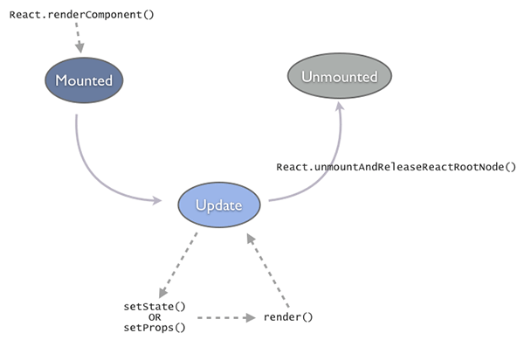
Components

Slide 21
Component Life cycle
getInitialState(): prepare initial state of the Component
componentWillMount()
componentDidMount()
componentWillReceiveProps()
shouldComponentUpdate(): useful if you want to control when a render should be skipped.
componentWillUpdate()
render()
componentDidUpdate()
componentWillUnmount()
The componentWill* methods are called before the state change and the componentDid* methods are called after.

Slide 22
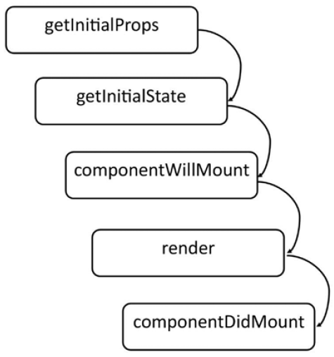
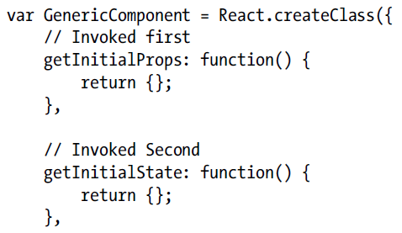
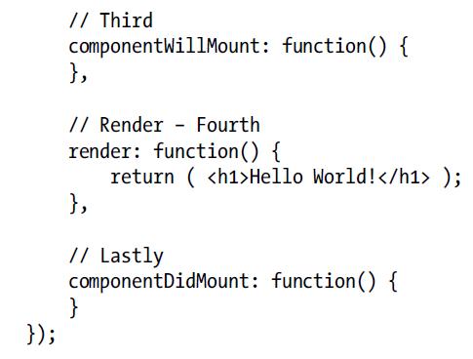
Life cycle during initial render
Note :We can not set state Here
Note :We can not set state Here
Eg Make ajax call and set state

Slide 23
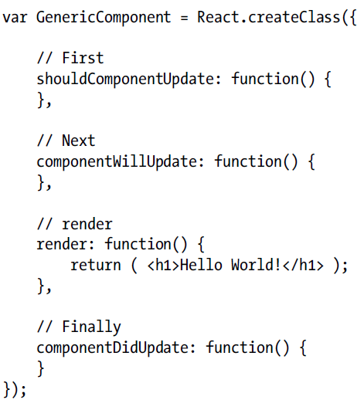
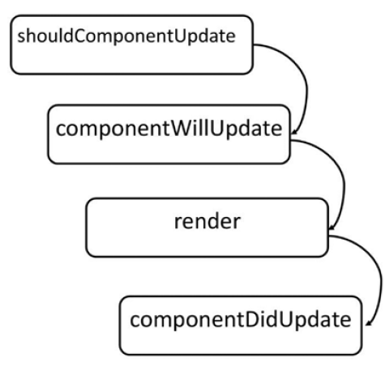
Life cycle during Change of State

Slide 24
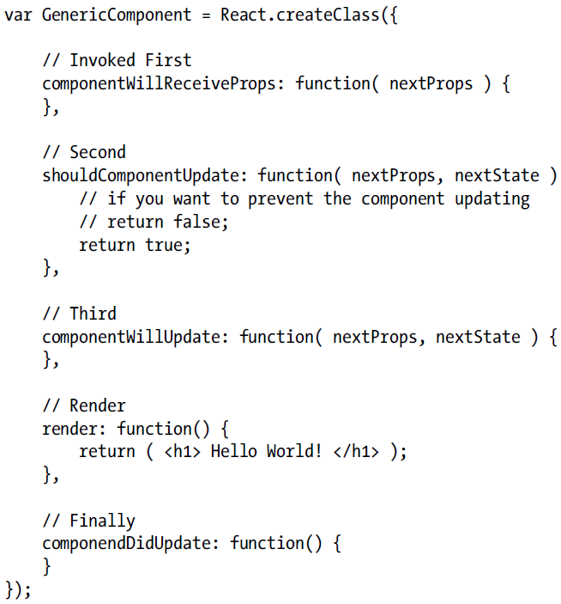
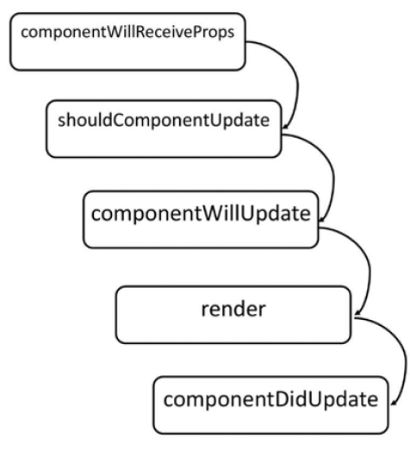
Life cycle during prop changes

Slide 25
Component Life Cycle
var HelloMessage = React.createClass({
componentWillMount: function() {
console.log('componentWillMount'); },
componentDidMount: function() {
console.log('componentDidMount'); },
componentWillUnmount: function() {
console.log('componentWillUnmount');
},
render: function() {
console.log('render');
return <h2>{this.props.message}</h2>;
} });

Slide 26
React
Once mounted, the component stays in the Update state. A component gets updated when we change state using setState() or change props using setProps().
This in turn results in calling render(), which brings the DOM in sync with the data (props + state).
Between subsequent updates, React will calculate the delta between the previous component-tree and the newly generated tree.
This is a highly optimized step (and a flagship feature) that minimizes the manipulation on the real DOM.

Slide 27
React
Unmounted state happens when we explicitly call React.unmountAndReleaseReactRootNode() or automatically if a component was a child that was no longer generated in a render() call.
Most often you don't have to deal with this and just let React do the proper thing.

Slide 28
Component Life cycle
Within a component-tree, data should always flow down.
A parent-component should set the props of a child-component to pass any data from the parent to the child.
This is termed as the Owner-Owned pair.
On the other hand user-events (mouse, keyboard, touches) will always bubble up from the child all the way to the root component, unless handled in between.

Slide 29
React – Controlled Component
An <input> with value set is a controlled component. In a controlled <input>, the value of the rendered element will always reflect the value prop.
render: function() {
return <input type="text" value="Hello!" />;
}
This will render an input that always has a value of Hello!.
Any user input will have no effect on the rendered element because React has declared the value to be Hello!.

Slide 30
React – Controlled Component
To update the value in response to user input, use the onChange event:
getInitialState: function() {
return {value: 'Hello!'}; },
handleChange: function(event) {
this.setState({value: event.target.value});
}, render: function() {
var value = this.state.value;
return <input type="text" value={value} onChange={this.handleChange} />;
}

Slide 31
React – Controlled Component
Here we are accepting the newest value provided by the user and updating the value prop of the <input> component.
This pattern makes it easy to implement interfaces that respond to or validate user interactions.
For example:
handleChange: function(event) {
this.setState({value: event.target.value.substr(0, 140)});
}
This would accept user input but truncate the value to the first 140 characters.
.

Slide 32
React – Controlled Component
Why Controlled Components?
Using form components such as <input> in React presents a challenge that is absent when writing traditional form HTML.
For example, in HTML:
<input type="text" name="title" value="Untitled" />
This renders an input initialized with the value, Untitled. When the user updates the input, the node's value property will change.
However, node.getAttribute('value') will still return the value used at initialization time, Untitled.

Slide 33
React – Controlled Component
Unlike HTML, React components must represent the state of the view at any point in time and not only at initialization time.
For example, in React:
render: function() {
return <input type="text" name="title" value="Untitled" />; }
Since this method describes the view at any point in time, the value of the text input should always be Untitled..

Slide 34
React – Uncontrolled Component
Uncontrolled Components
An <input> that does not supply a value (or sets it to null) is an uncontrolled component.
render: function() { return <input type="text" />; }
.

Slide 35
React
Default Value
To initialize the component with a non-empty value, supply a defaultValue prop.
render: function() {
return <input type="text" defaultValue="Hello!" />; }
This example will function much like the Controlled Components
<input> supports defaultChecked
<select> supports defaultValue.
.

Slide 36
React – Lifecycle methods
Once mounted, the component stays in the Update state.
A component gets updated when we change state using setState().
This in turn results in calling render(), which brings the DOM in sync with the data (props + state).
Between subsequent updates, React will calculate the delta between the previous component-tree and the newly generated tree to optimize and minimizes the manipulation on the real DOM.

Slide 37
React – Lifecycle methods
The final state is Unmounted.
This happens when we explicitly call React.unmountAndReleaseReactRootNode() or automatically if a component was a child that was no longer generated in a render() call.
React tell when it moved between the Mounted-Update-Unmounted states using built-in methods

Slide 38

React – methods
Mounting methods :
getInitialState(): object is invoked before a component is mounted. Stateful components should implement this and return the initial state data.
componentWillMount() is invoked immediately before mounting occurs.
componentDidMount() is invoked immediately after mounting occurs.
Initialization that requires DOM nodes should go here.

Slide 39
React – Lifecycle methods
Updating methods:
componentWillReceiveProps(object nextProps) is invoked when a mounted component receives new props. This method should be used to compare this.props and nextProps to perform state transitions using this.setState().
shouldComponentUpdate(object nextProps, object nextState): boolean is invoked when a component decides whether any changes warrant an update to the DOM.
Implement this as an optimization to compare this.props with nextProps andthis.state
with nextState and return false if React should skip updating.

Slide 40
React – Lifecycle methods
Updating methods:
componentWillUpdate(object nextProps, object nextState) is invoked immediately before updating occurs. You cannot call this.setState() here.
componentDidUpdate(object prevProps, object prevState) is invoked immediately after updating occurs.
.

Slide 41
React – Lifecycle methods
Unmounting
componentWillUnmount() is invoked immediately before a component is unmounted and destroyed. Cleanup should go here.
Mounted Methods
findDOMNode(): DOMElement can be invoked on any mounted component in order to obtain a reference to its rendered DOM node.
forceUpdate() can be invoked on any mounted component when we know that some deeper aspect of the component's state has changed without using this.setState().
.

Slide 42
React - prop
Component can contain attributes called props.
this.props is used in render method to render dynamic data:
var MyComponent = React.createClass({
render: function(){
return (
<h1>Hello, {this.props.name}!</h1>
);
}});
React.render(<MyComponent name="Handsome" />, document.getElementById('myDiv'));

Slide 43
React – Specs, Lifecycle, State
Specs
getInitialState – Return value is the initial value for state.
getDefaultProps – Sets fallback props values if props aren’t supplied.
mixins – An array of objects, used to extend the current component’s functionality.

Slide 44
Mixins
mixins is a React feature that allows to share cross cutting concerns with components.
A mixin is simply an Object Literal that is used to add behavior to a component.
It's an implementation of the decorator pattern and the mixin provide implementations of React's component lifecycle events (componentWillMount, componentDidMount, and so on) and those will be called during component's lifecycle along with the component's lifecycle methods.

Slide 45
React – State
State
Every component has a state object and a props object.
State is set using the setState method.
Calling setState triggers UI updates.
getInitialState method used to set initial state.

Slide 46
React – State
Within a component-tree, data should always flow down.
A parent-component should set the props of a child-component to pass any data from the parent to the child.
This is termed as the Owner-Owned pair.
user-events (mouse, keyboard, touches) will always bubble up from the child all the way to the root component, unless handled in between.

Slide 47
React – State
Unidirectional Data Flow
In React, application data flows unidirectionally via the state and props objects, as opposed to the two-way binding of libraries like Angular.
In a multi component heirachy, a common parent component should manage the state and pass it down the chain via props.
state should be updated using the setState method to ensure that a UI refresh will occur.
The resulting values should be passed down to child components using attributes that are accessible in said children via this.props.

Slide 48
React – ref
The ref String Attribute
React supports a very special property that can be attached to any component that is output from render().
This special property allows to refer to the corresponding backing instance of anything returned from render(). It is always guaranteed to be the proper instance, at any point in time.

Slide 49
React – ref
The ref String Attribute
Assign a ref attribute to anything returned from render such as:
<input ref="myInput" /> In some other code (typically event handler code), access the backing instance via this.refs as in:
this.refs.myInput : can access the component's DOM node directly
React.findDOMNode(this.refs.myInput).

Slide 50
React – ref
The ref String Attribute
render: function() {
return (
<TextInput
ref={function(input) {
if (input != null) {
input.focus();
}
}} />
);
}, (refddemo.html)

Slide 51
React - ref
create the intermediate-DOM in render(), to assign a ref property to a child component then refer to it from the parent using the refs property.
render: function(){ // Set a ref
return (
<div> <span ref="counter"
class="count">{this.state.count}</span> </div>;
)}
handleMouseDown: function(){ // Use the ref console.log(this.refs.counter.innerHTML);
},

Slide 52
React - ref
The ref Callback Attribute
The ref attribute can be a callback function instead of a name.
This callback will be executed immediately after the component is mounted.
The referenced component will be passed in as a parameter, and the callback function may use the component immediately, or save the reference for future use (or both).

Slide 53
React
React Addons
https://github.com/STRML/react-addons

Slide 54
React – Two Way Data Binding
Two way data binding without Reactlink:
var NoLink = React.createClass({
getInitialState: function() {
return {message: 'Hello!'};
},
handleChange: function(event) {
this.setState({message: event.target.value});
}, render: function() {
var message = this.state.message;
return <input type="text" value={message} onChange={this.handleChange} />; }
});

Slide 55
React – Two Way Data Binding
Two way data binding with ReactLink :
var WithLink = React.createClass({
mixins: [React.addons.LinkedStateMixin],
getInitialState: function() {
return {message: 'Hello!'};
},
render: function() {
return <input type="text" valueLink={this.linkState('message')} />;
}
});

Slide 56
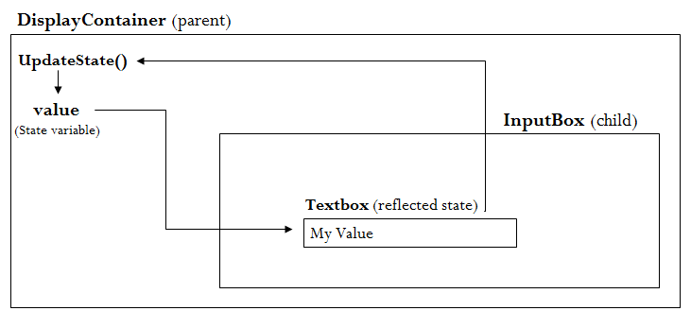
React – Two Way Data Binding
The ‘DisplayContainer’ will display a state variable of it and ‘InputBox’ will be a child of ‘DisplayContainer’, which will have a textbox in it.
Murthy
Demo: Two way data binding

Slide 57
React – Cross Browser
Polyfills Needed to Support Older Browsers
es5-shim.js from kriskowal's es5-shim provides the following that React needs:
Array.isArray
Array.prototype.every
Array.prototype.forEach
Array.prototype.indexOf
Array.prototype.map
Date.now
Function.prototype.bind
Object.keys
String.prototype.split
String.prototype.trim

